Slide 1


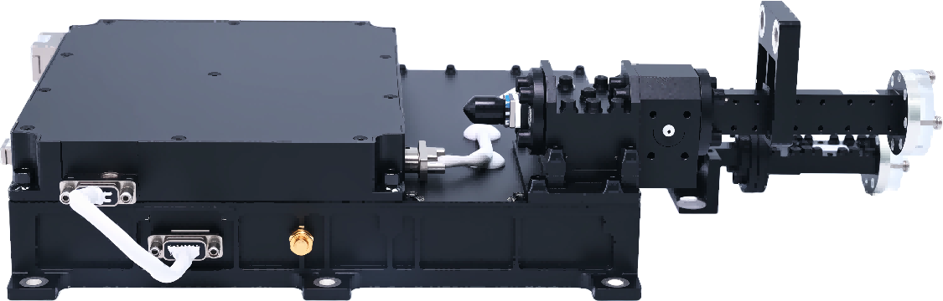
QV-band RF Front-End
JL2.800.0010
Expert in Infrared Thermal Imaging Technology & RF-Microwave Products
QV-band RF Front-End Technical Data Sheet
Product Functions
Receive a V-band uplink signal (including multiple service signals + 1 accompanying telecommand signal) from the antenna and perform low-noise amplification.
Receive signals, amplify the power to ≥ 38.5 dBm, and output to the antenna.
Internal power distribution and control. Configure power supply according to operational requirements and provide agreed telemetry data.
Switching and telemetry functions. The solid-state amplifier includes switch control.
Undervoltage protection, overtemperature protection, and output overcurrent protection.
Applications
Test & Measurement
Space Systems
Satellite
Instrumentation
Military Communications
Communication Systems
Core Features
Test Item | Performance Indicator | Unit
Forward Input/Output Signal Frequency | QV-band | GHz
Reverse Input/Output Signal Frequency | QV-band | GHz
Forward Input/Output Level | Service Input: -87 to -57 Service Output: -40 to -10 | dBm
 | Telecommand Input: -87 to -57 Telecommand Output: -40 to -10 | dBm
Reverse Input/Output Level | Single Beam Input: -19±1 Single Beam Output: ≥ 32.5 | dBm
 | Multi-Beam Input: -13±1 Multi-Beam Output: ≥ 38.5 | dBm
 | Telemetry Input: -29±1 Telemetry Output: ≥ 22.5 | dBm
Reverse EVM | ≤ 7% (4 beams, 12 carriers, 16QAM) | %
Notes:
Values at 25℃, sea level.
www.mwglobe.com Email: sales@mwglobe.com

Slide 2
QV-band RF Front-End
JL2.800.0010
Expert in Infrared Thermal Imaging Technology & RF-Microwave Products
QV-band RF Front-End Technical Data Sheet
Test Item | Performance Indicator | Unit
ACPR | ≤ -20 (100MHz integration bandwidth; adjacent channel spacing 100 MHz) | dBc
Forward In-Band Flatness | ≤ 0.6 (any 240 MHz effective bandwidth); ≤ 2 (47.2~49.2 GHz) | dB
Reverse In-Band Flatness | ≤ 0.6 @ 37.5~38 GHz | dB
Forward Out-of-Band Rejection | ≤ -65 @ 37.5~40 GHz | dBc
Reverse Out-of-Band Rejection | ≤ -52 @ 42.5~43.5 GHz | dBc
 | ≤ -65 @ 47.2~49.2 GHz ≤ -80 @ 14~14.5 GHz | dBc dBc
 | ≤ -65 @ 1.2~1.6 GHz | dBc
Noise Figure | ≤ 4.0 | dB
VSWR | VSWR ≤ 1.5
Interface Definitions
Recommended Power Supply Voltage:
Rated +42 V, tolerance range +37 V to +46.2 V;
Power on/off controlled by an external TTL signal;
Single QV RF front-end power consumption: ≤5 W (standby), ≤ 115 W (operational).
Electrical Interfaces:
Insulation resistance between isolated circuits and the casing under normal conditions: ≥10 MΩ;
The outer shell surface should be electrically conductive, with resistance ≤10 mΩ between any two points.
Dimensions and Weight:
Envelope dimensions: ≤287.86 mm (W) × 224.52 mm (L) × 86 mm (H);
Weight: ≤2.03 kg.
External Interfaces:
The QV RF front-end has a total of 6 external interfaces: 4 RF interfaces and 2 low-frequency interfaces. Details are as follows
www.mwglobe.com Email: sales@mwglobe.com

Slide 3
QV-band RF Front-End
JL2.800.0010
Expert in Infrared Thermal Imaging Technology & RF-Microwave Products
QV-band RF Front-End Technical Data Sheet
Connector Code | Functional Description | Connector Model
X01G | VRxin | WR22
X02G | QTxout | WR22
X03G | VRxout | 2.4-K
X04G | QTxin | 2.4-K
X05 | Power Interface | J36A-9ZJ
X06 | Detection | J30JA-9ZK
Recommended Temperature
Storage temperature range: -20 ℃ to +55 ℃
Operating temperature range: -15 ℃ to +45 ℃
Ground storage temperature: -10℃ to +45℃
Radiation Resistance
Total Ionizing Dose (TID): ≥ 43 krad (Si)
Single Event Latch-up (SEL): 37 MeV·cm²/mg
Precaution
RF Port Protection:
Do not power on without a 50 Ω load;
Wear an anti-static wristband (impedance 1 MΩ) during operation.
Power Sequence Requirements:
Power-on sequence: Apply +42 V first, then enable the TTL signal with a delay of ≥100 ms.
www.mwglobe.com Email: sales@mwglobe.com

Slide 4
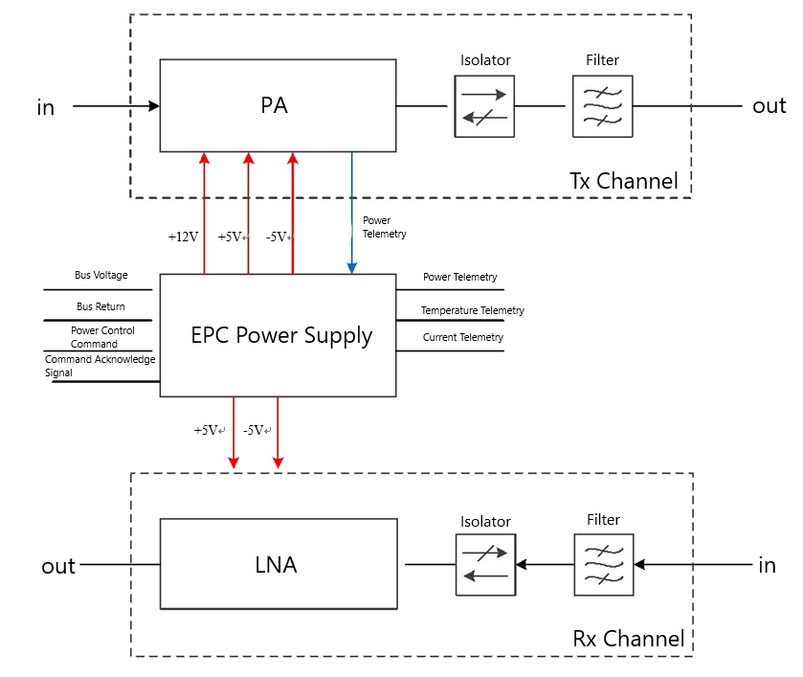
QV-band RF Front-End
JL2.800.0010
Expert in Infrared Thermal Imaging Technology & RF-Microwave Products
QV-band RF Front-End Technical Data Sheet
Q/V RF Front-End System Block Diagram
www.mwglobe.com Email: sales@mwglobe.com

Slide 5
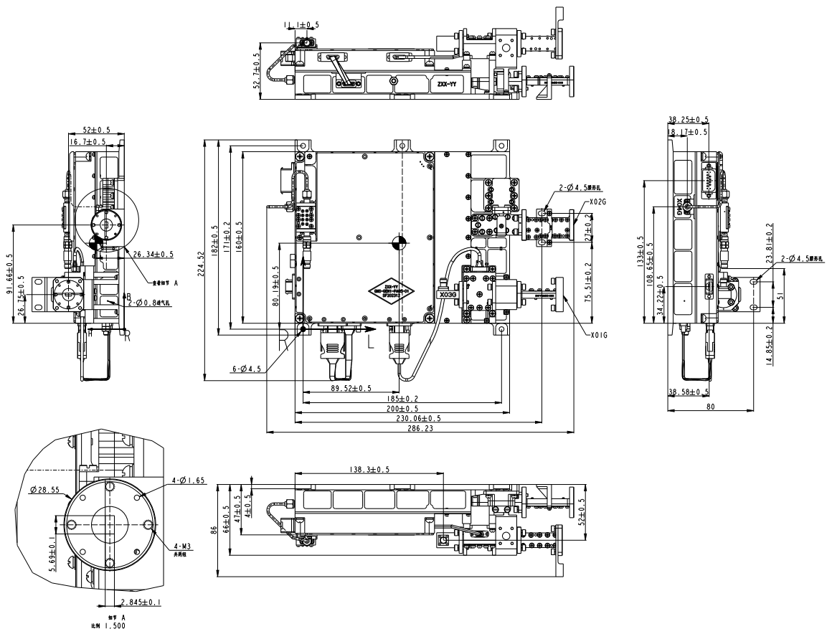


NOTES: 1.UNLESS OTHERWISE SPECIFIED ALL DIMENSIONS ARE NOMINAL. 2.ALL SPECIFICATIONS ARE SUBJECT TO CHANGE WITHOUT NOTICE. 3.DIMENSIONS ARE IN mm.
 | PART NAME
 | QV-band RF Front-End
 |  | REV | DATE
Tel: +86 135 1916 6509 |  | V1.0 | 2026.4.9
Website: www.mwglobe.com |  | SCALE 1:1
E-Mail: sales@mwglobe.com
Q/V RF Front-End External Diagram
JL2.800.0010

